Slide 1
Explore the House Price in the Boston Market
Designed By Min Xiong

Slide 2
Background Material
I got this data of boston house price from the U.S Census Service concerning housing in the area of Boston Mass . I want to analysis which factor will impact the house price and how to impact the house price.

Slide 3
Shiny App ‘S Link:
Shiny App:
https://min68.shinyapps.io/newtest/
Github Link:
https : //GitHub - Min6886/Shiny-App

Slide 4
Data Describtion
This dataset contains information collected by the U.S Census Service concerning housing in the area of Boston Mass . The dataset is in size with only 506 cases.
There are 15 attributes in each case of the dataset.

Slide 5
15 varibles meaning:
CRIM: Per capita crime rate by town
ZN: Proportion of residential land zoned for lots over 25,000 sq. ft
INDUS: Proportion of non-retail business acres per town
CHAS: Charles River dummy variable (= 1 if tract bounds river; 0 otherwise)
NOX: Nitric oxide concentration (parts per 10 million)
RM: Average number of rooms per dwelling
AGE: Proportion of owner-occupied units built prior to 1940
DIS: Weighted distances to five Boston employment centers
RAD: Index of accessibility to radial highways
TAX: Full-value property tax rate per $10,000
PTRATIO: Pupil-teacher ratio by town
LSTAT: Percentage of lower status of the population
MEDV: Median value of owner-occupied homes in $1000s
CAT.MEDV: when it is 0, that mean MEDV < 30, when it is 1, that mean MEDV >30.
Validation : there two types of set- one is training data, one is validation data.

Slide 6
Visualization Tool
Shiny App include ui.r, sever.r ,house price .csv and readme file.
Ui.r tell the interface , server.r tell how to do this process.
Through the browse, download the house price .csv file.
Then check the right side of panel. You will see the data set structure,data header ,summary ,etc.
There are four main visualization tools: scatterplot, boxplot ,histogram and plot - brushing.

Slide 7
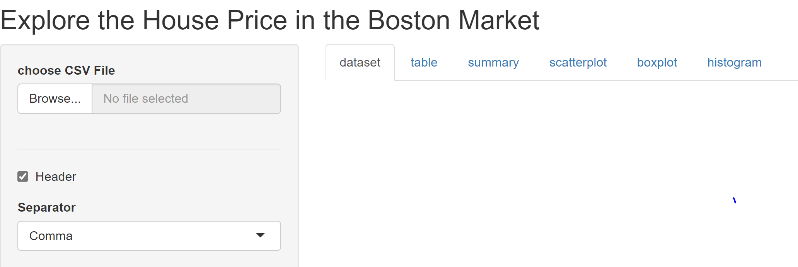
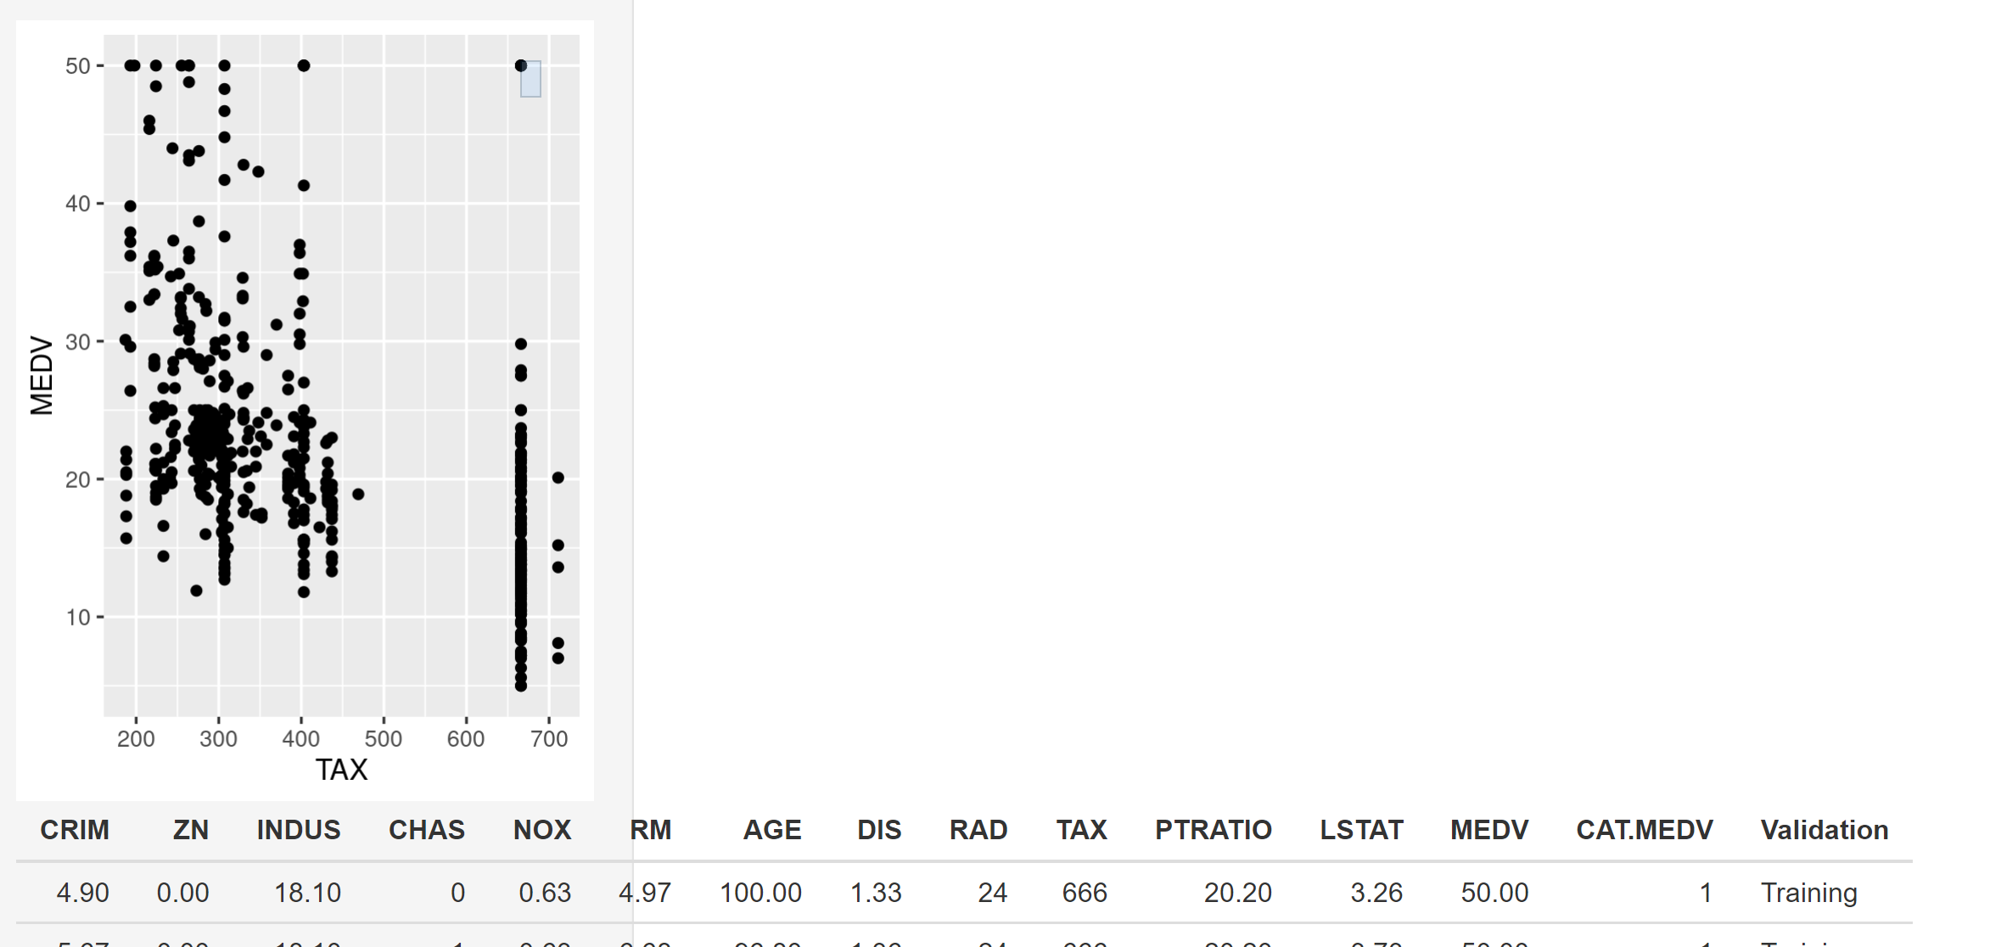

Slide 8
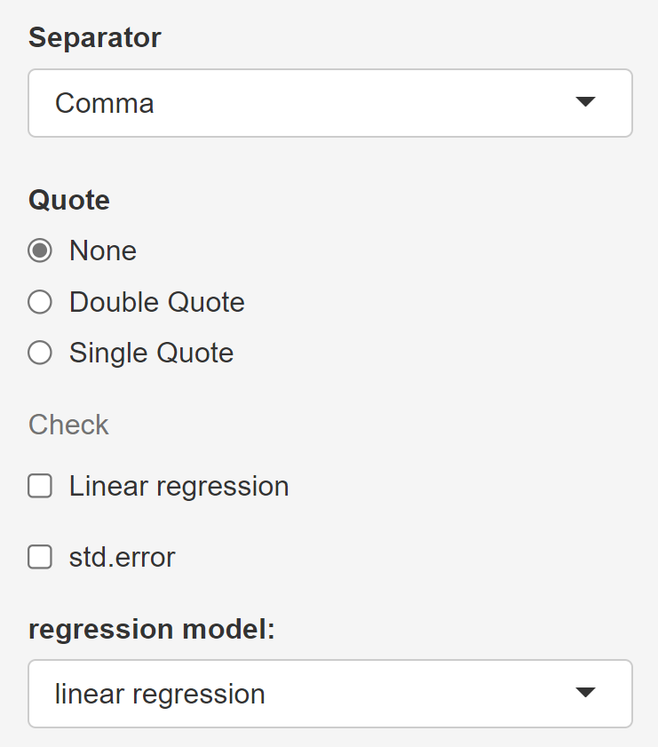
When you download csv file from browse, first you can choose data format. There are three types of format:comma, semicolon and tab.
If it is character , it can choose none, double quote and single quote.

Slide 9
Principles
When data is standard formatting, then choose the model to do the analysis.
This dataset I choose the multiple linear regression. When you choose the model, the summary will come out and shows coefficients with every variables , std error,p –value and r square etc.
Then choose display the scatterplot. First you need to choose the first x varible , MEDV is default y. We have list of variables ,you can pull down the varible box. After you choose one x varible, then click the “linear regression” and “std error” ,the scatterplot will shows relationship with the x and y , also has lightly gray line will surround the linear regression line . If you choose different x varible, there are different lines there.

Slide 10
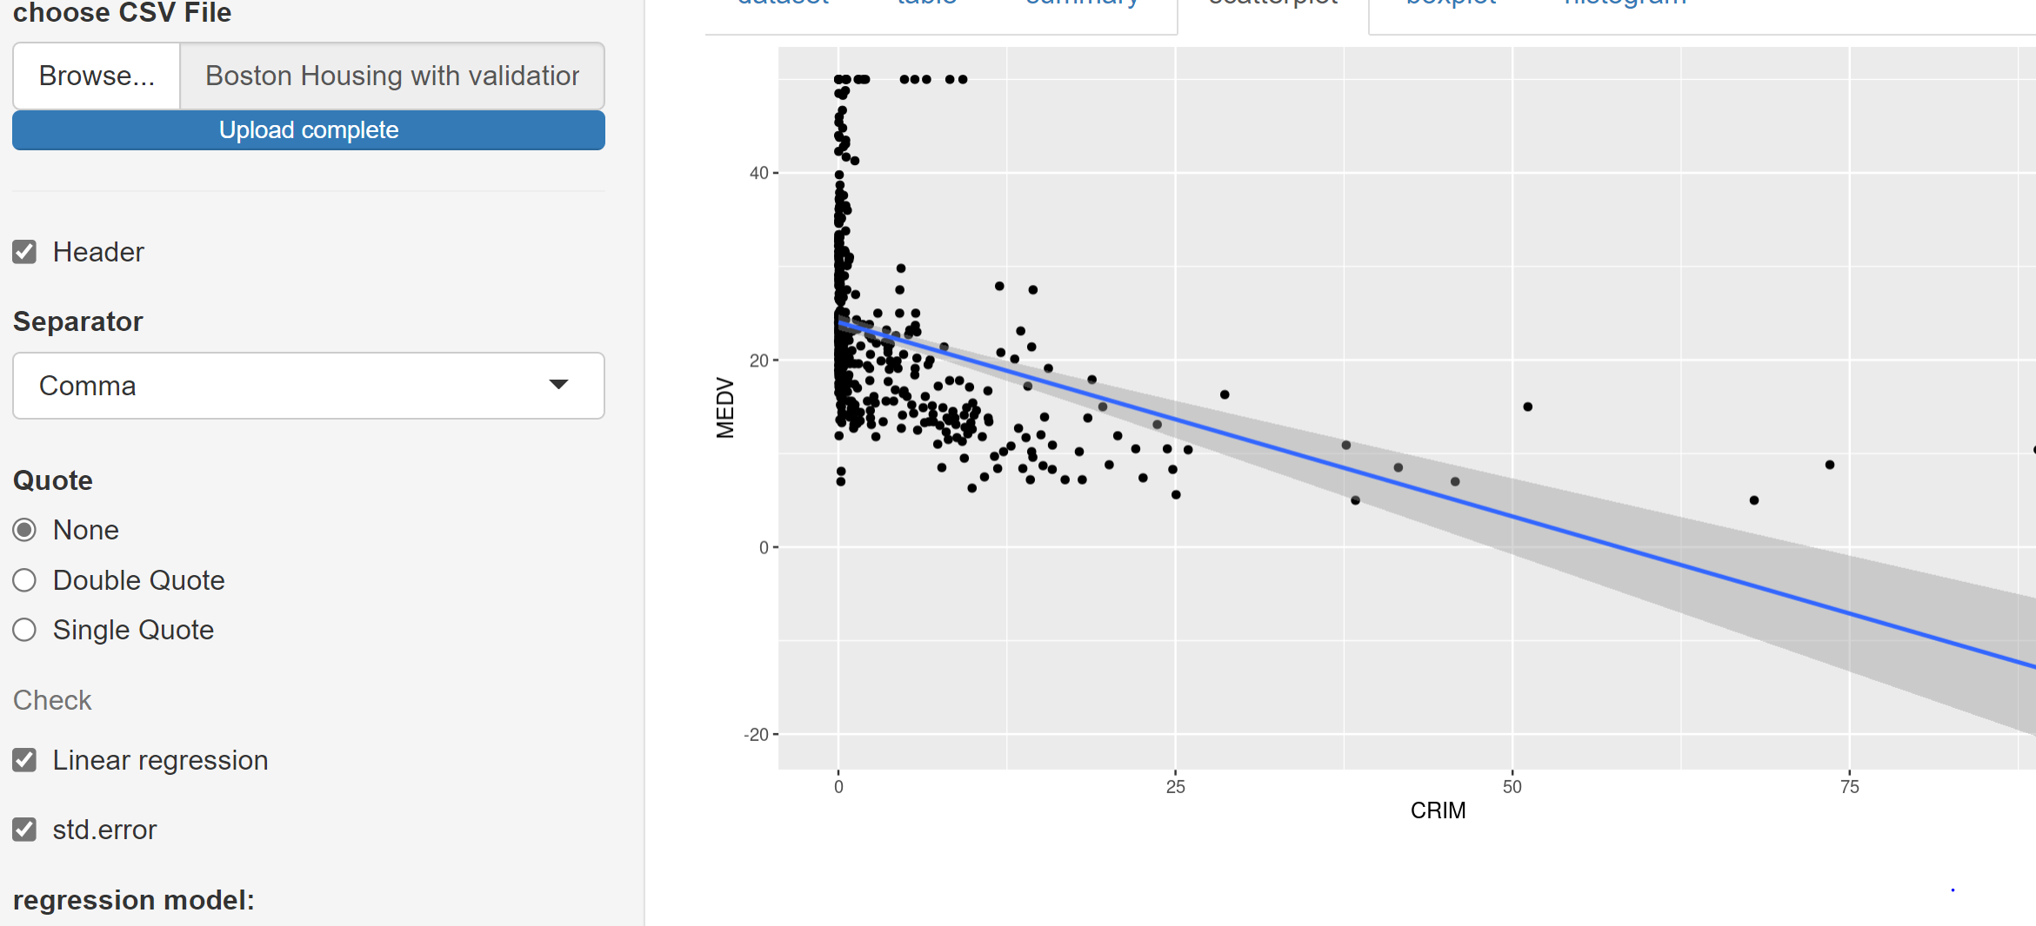
Scattorplot
This shows CRIM and MEDV has negative linear relationship .When CRIM is increasing, and MEDV is decreasing.

Slide 11
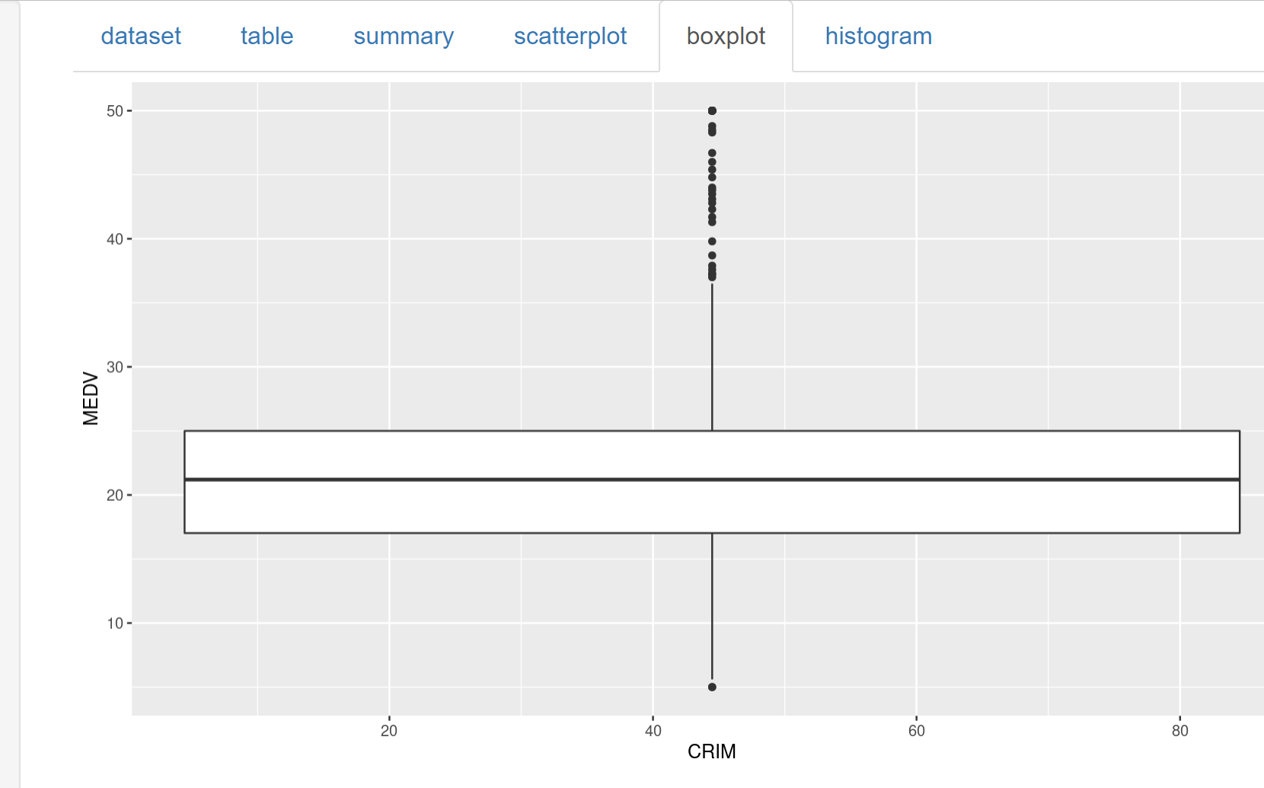
Boxplot
When you click “boxplot” tab, you can get boxplot result. So you can see the median price ,outliner of MEDV from the boxplot.

Slide 12
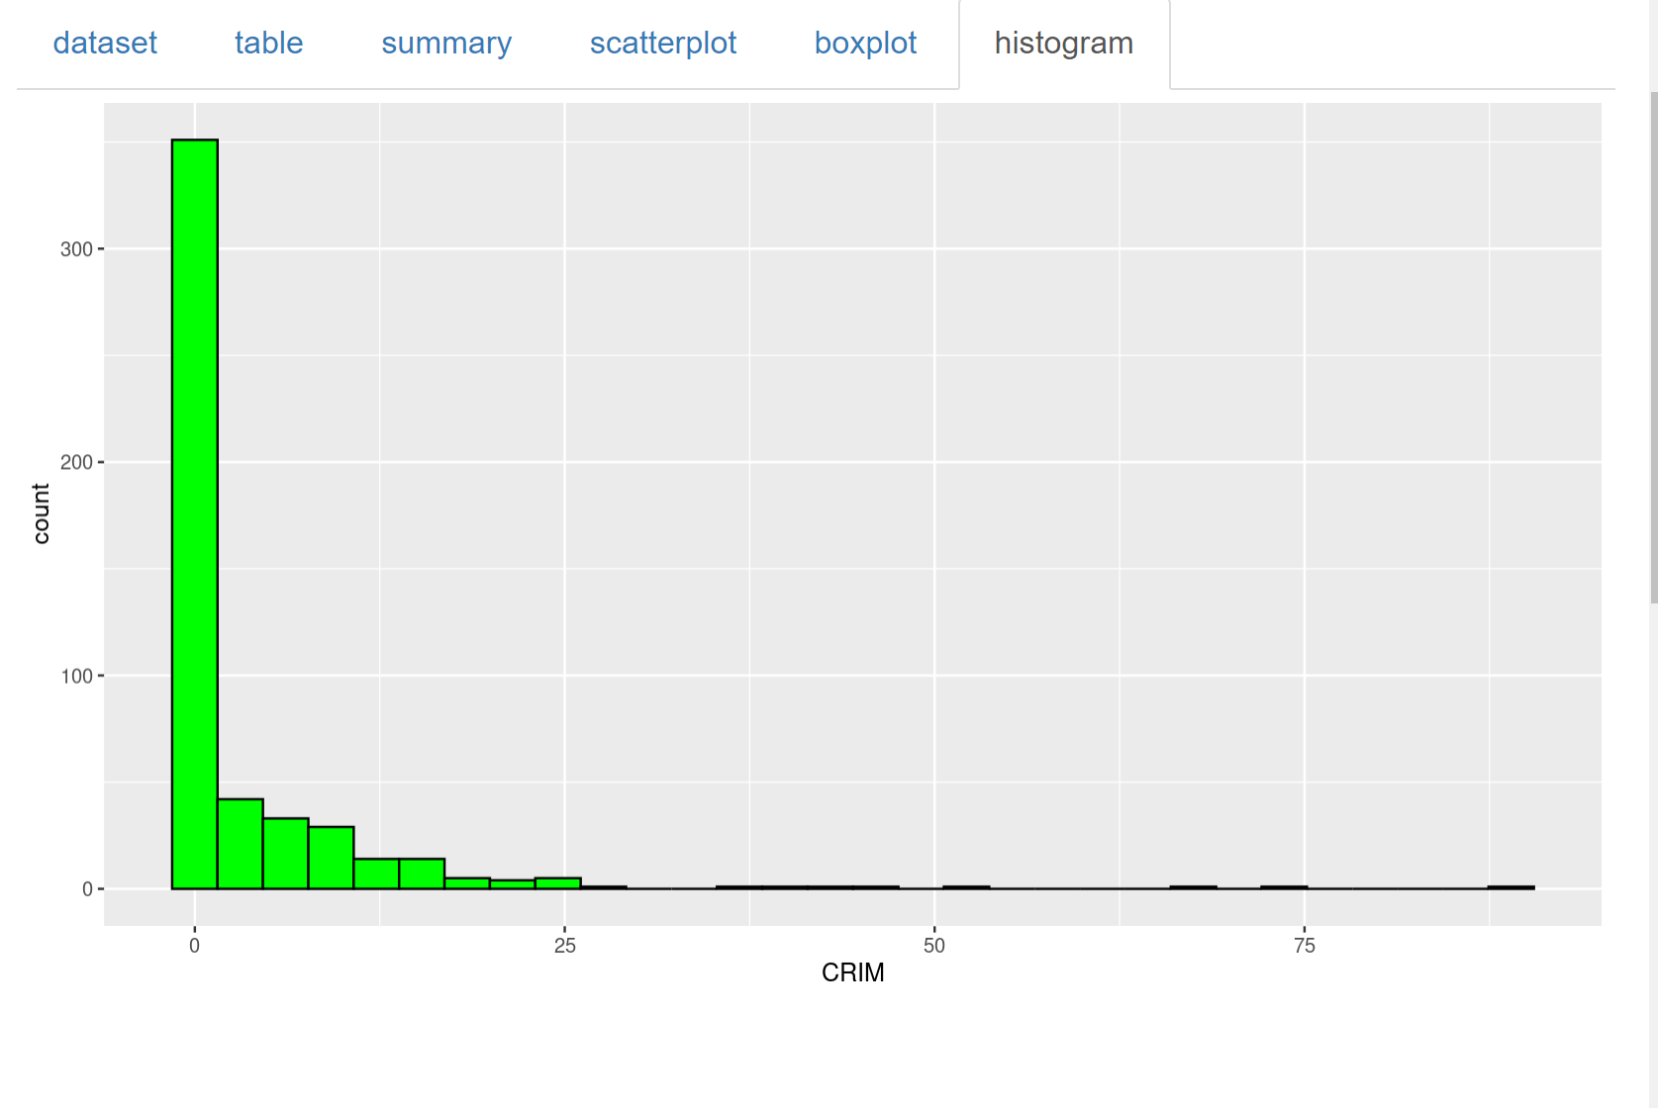
Histogram
When you choose histogram, you can get count of every variables.

Slide 13
Plot - Brushing
When you choose the plot brushing , you will check any point of tax, there are relative variables which will show up. For example, if I choose the tax is 666, there are different crimes , different ages ,different chas, but there are same MEDV. That is interesting found. How to choose the plot brushing, you can see the arrow turn to the cross, then you pull down the dot, and it will shows up the table of data.

Slide 14
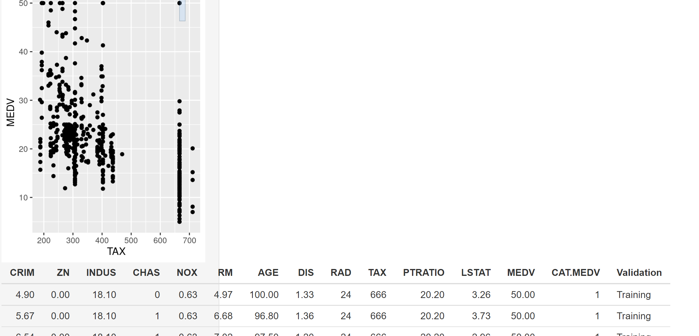

Slide 15
Data Story
I choose the dataset because my cousin will move to the Boston, he want to buy the new house. I want to help him to find the factor which will impact the price and how to impact the price. He is very happy and said I help him to find the good analysis model to him. That is multiple linear regression model. Right now he knows these factors include CRIM, AGE, RAD and LAST have strong negative linear relationship with MEDV. When these factors are smaller ,then the MEDV will be higher. But RM and DIS have strong positive linear relationship with MEDV. When these factors are bigger, then the MEDV will be higher.

Slide 16
The End

